Slide 1
FreeLance Forge
Team -3
Asritha Pallapotu- Project Manager
Amar Gopal Kapalavai- Product Owner
Syed Adnan- Business Analyst
Yugantkumar Gajera- Lead Developer
Venkata Puneeth Nannapaneni- Developer
Naveen Kumar Kukutla- Lead DBA
Dhvani Dilipbhai Borda- QA Analyst
Jensikumari Ishvarbhai Jasoliya- Software Tester
Sai Aneesh- Software Tester
Akhil Yadati- Software Tester
CS691_CRN23288 - Capstone Project

Slide 2
AGENDA
BRM Diagram
Context Diagram
RoadMap
RCT (main view only)
User Stories
UML Activity Diagram
ER Diagrams
Burndown Charts
Jenkins Progress Report
Live [Recorded] Application Demo

Slide 3
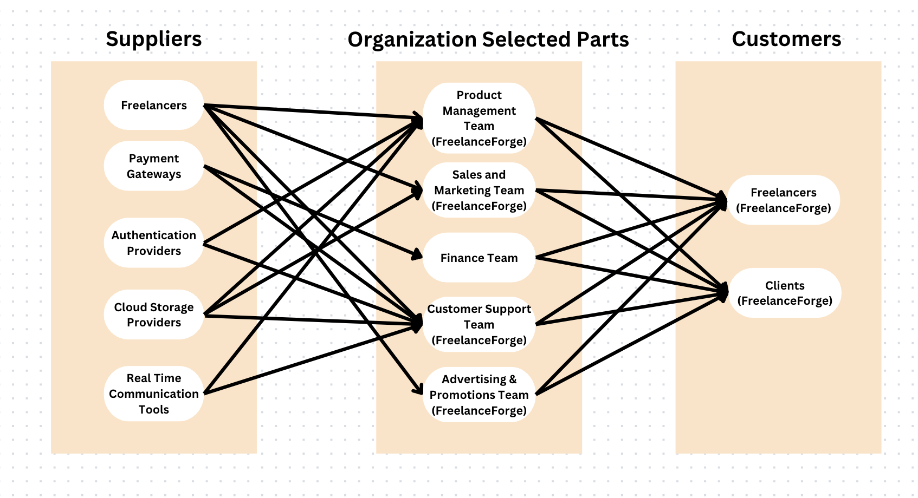
BRM DIAGRAM – (Yugantkumar Gajera)

Slide 4
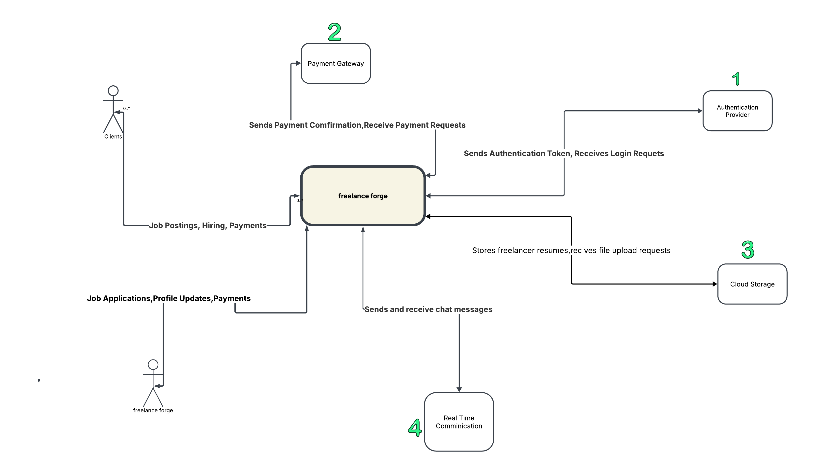
CONTEXT DIAGRAM-(Dhvani Dilipbhai Borda)

Slide 5
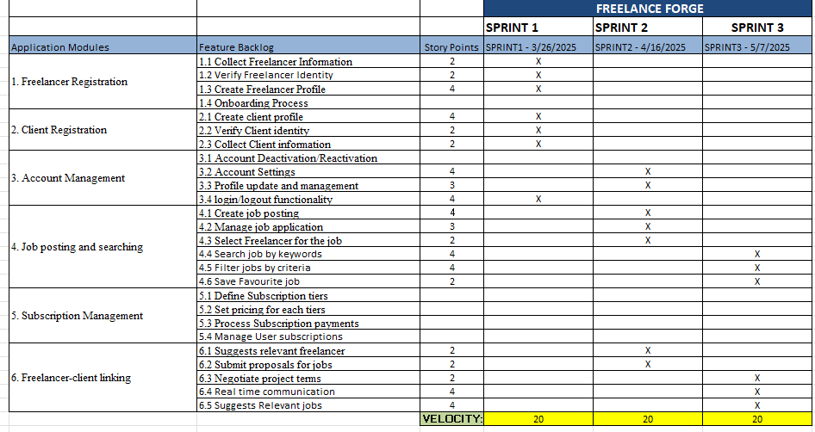
ROAD MAP- (Amar Gopal Kapalavai)

Slide 6
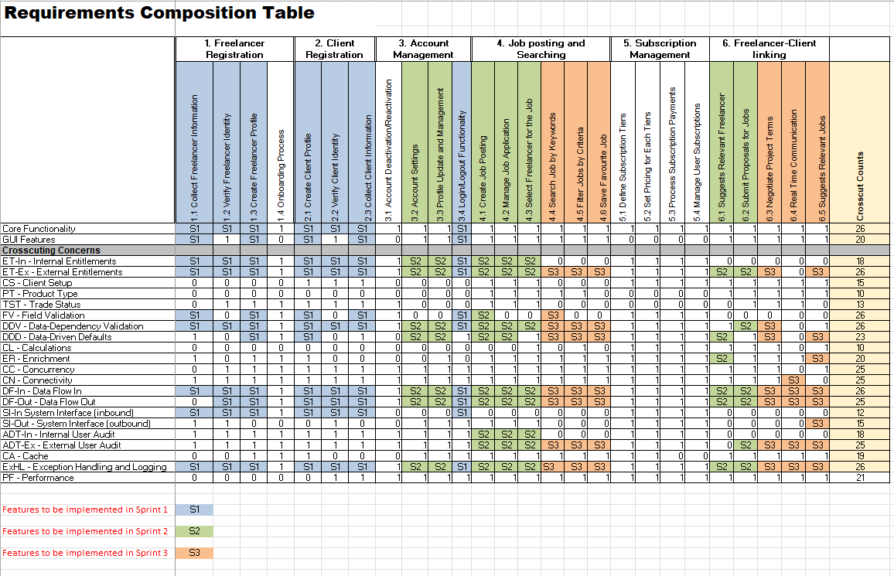
RCT –(Jensikumari Ishvarbhai Jasoliya)

Slide 7
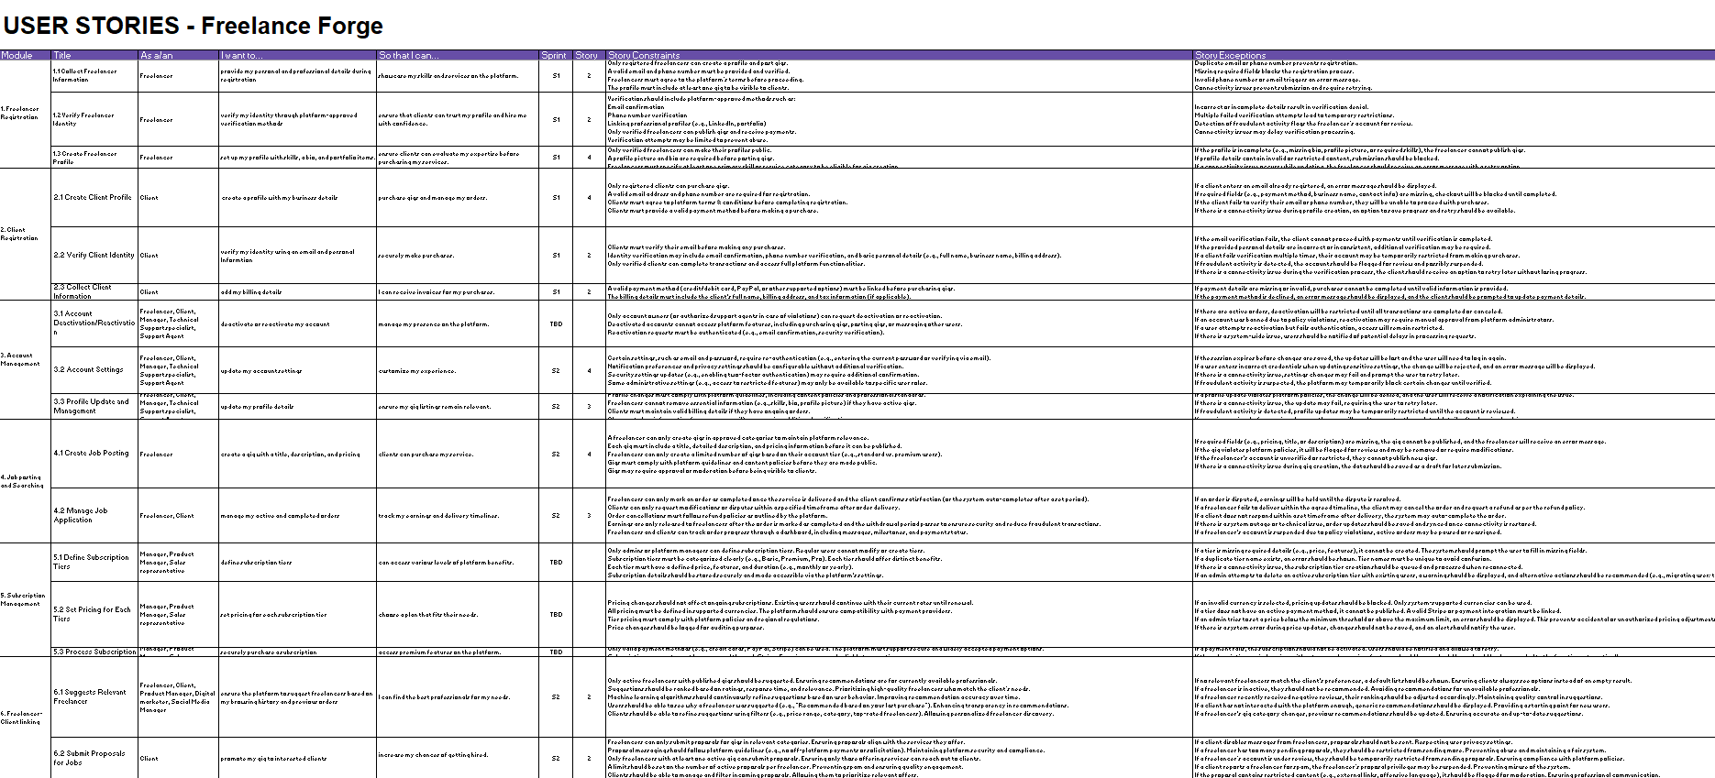
USER STORIES (Sai Aneesh)

Slide 8
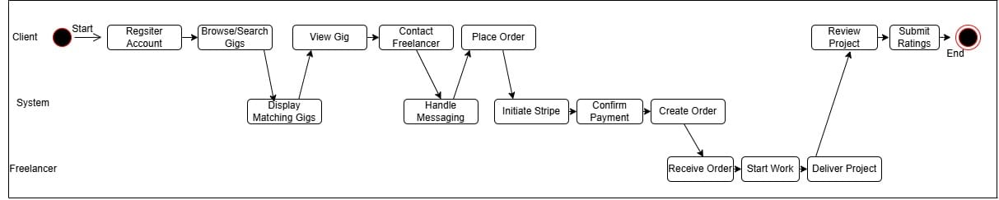
UML ACTIVITY DIAGRAM-(Syed Adnan)

Slide 9
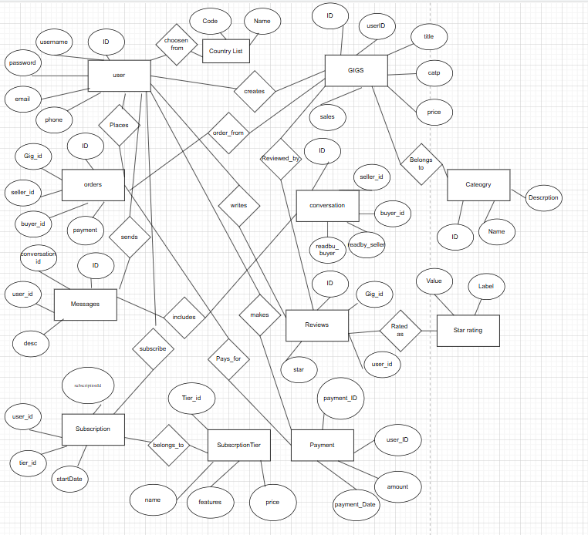
ER DIAGRAM – Conceptual (Naveen Kumar Kukutla)

Slide 10
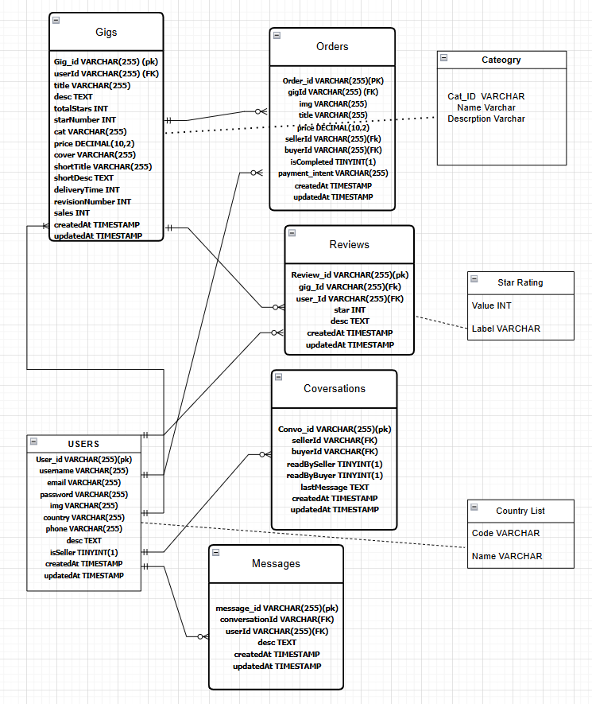
ER DIAGRAM –LOGICAL (Naveen Kumar Kukutla)

Slide 11
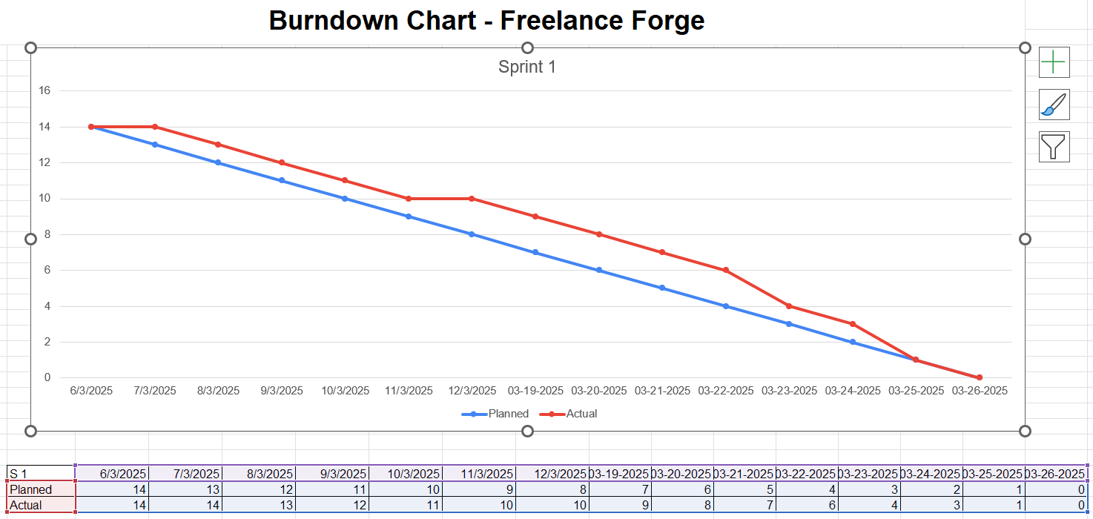
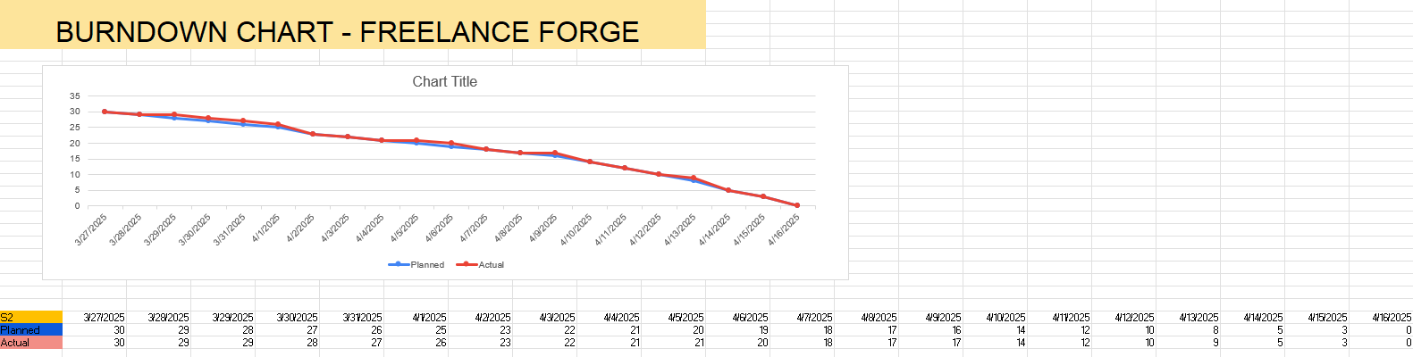
BURNDOWN CHARTS (Akhil Yadati)

Slide 12
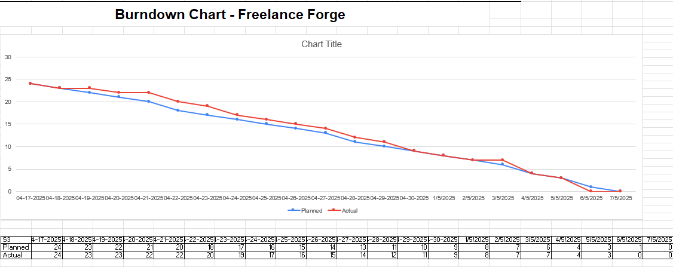
BURNDOWN CHARTS(Akhil Yadati)

Slide 13
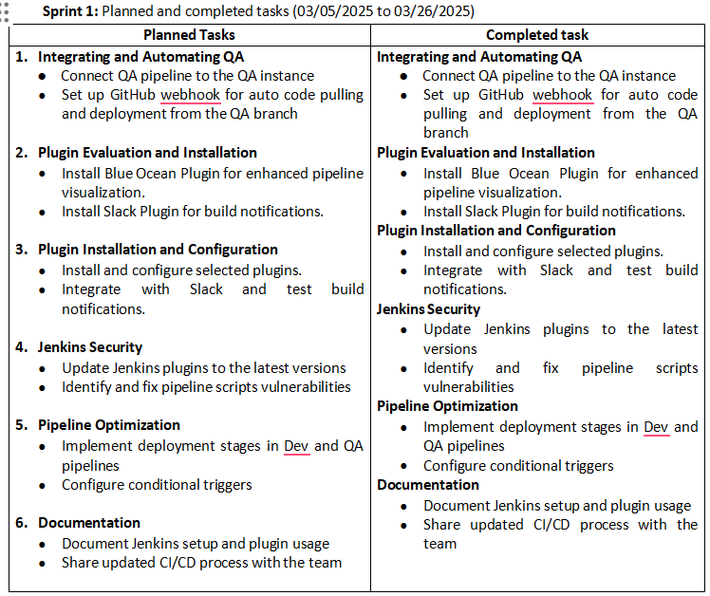
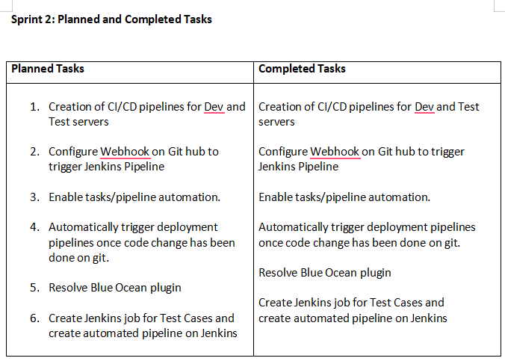
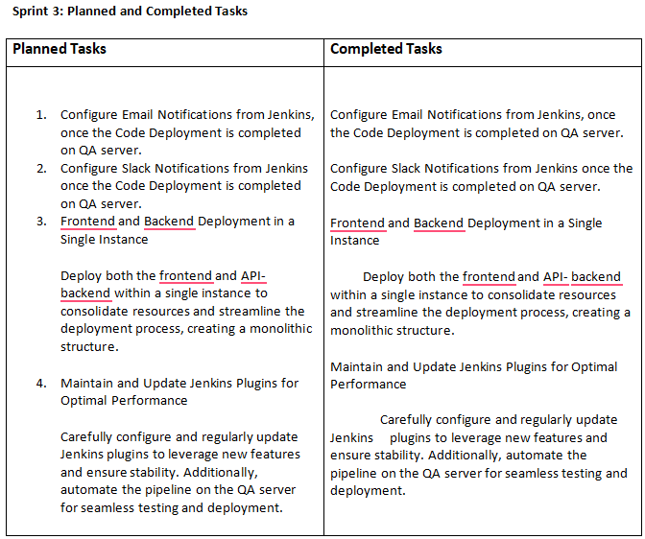
JENKINS PROGRESS REPORT (Venkata Puneeth Nannapaneni)

Slide 14
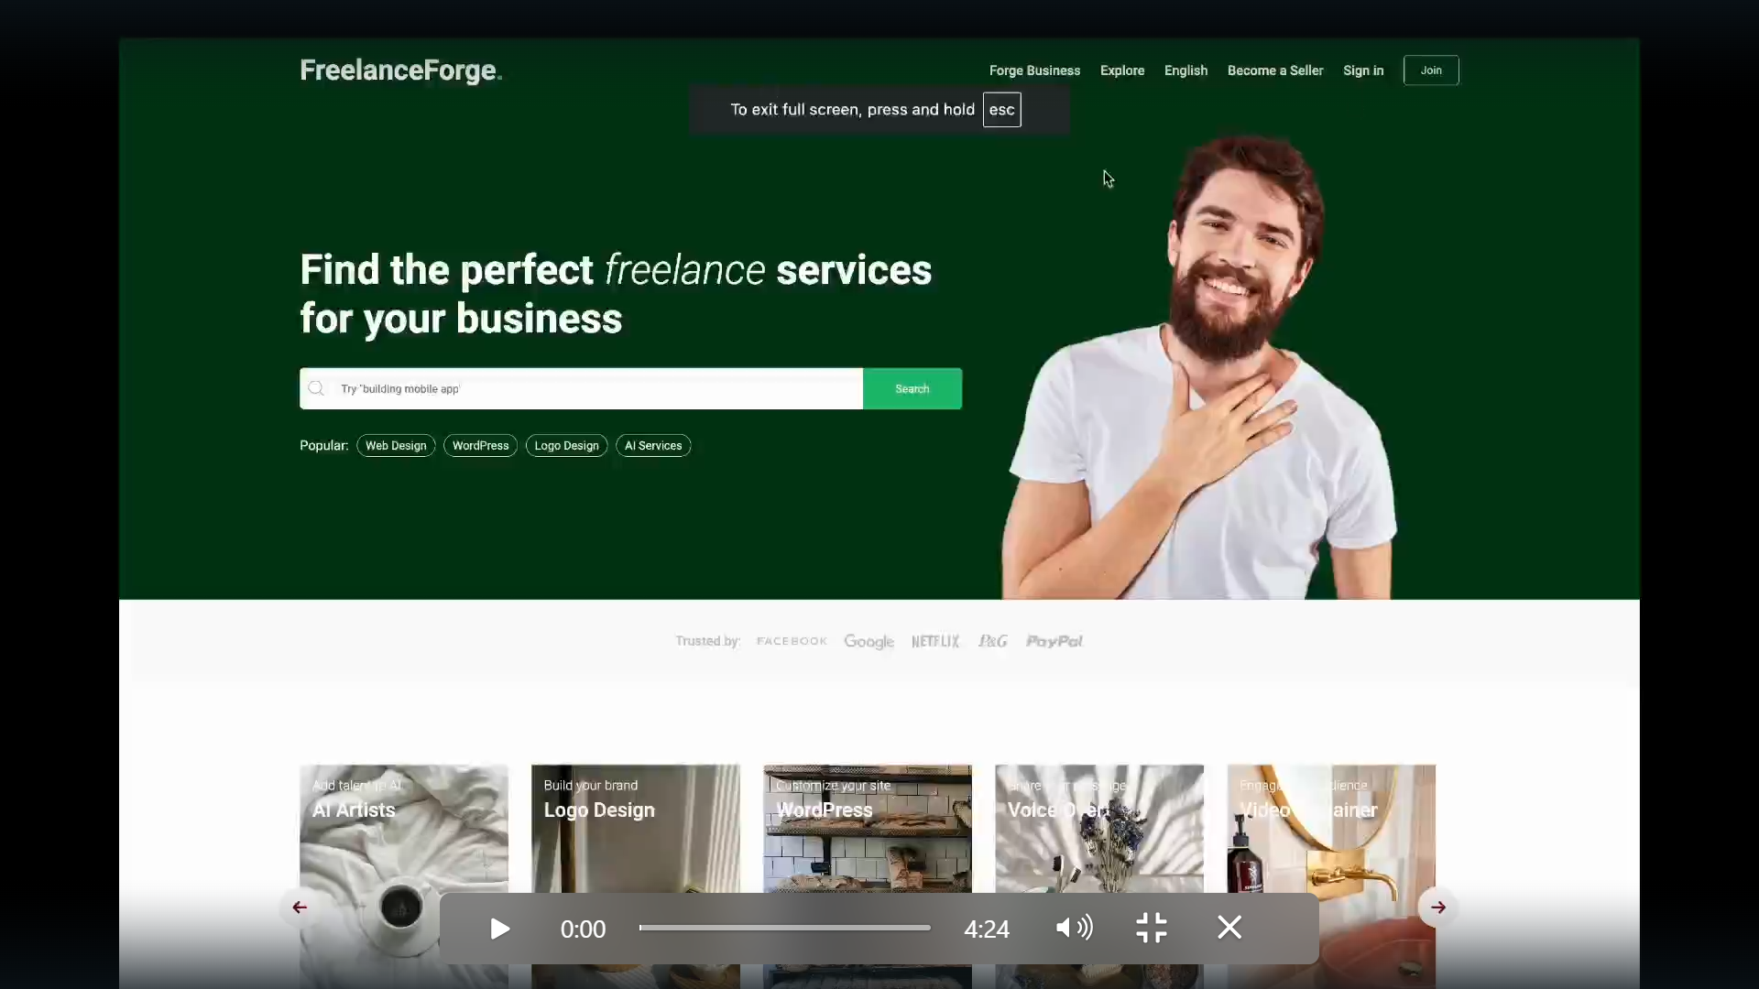
LIVE DEMO (Asritha Pallapotu)

